Slide 1

PARROT: AN ABSTRACTIVE MEETING SUMMARIZATION APPLICATION MSCS-Data Science Specialization Capstone Project (10-weeks)
Team Members: Anjali Sebastian, Vincent Marklynn, Yong Long Tan
Advisor: Dr. Wan Bae, Sponsor: Dr. Sada Narayanappa (Geospace.org)
Special thanks to Renny Philipose for technical support

Slide 2
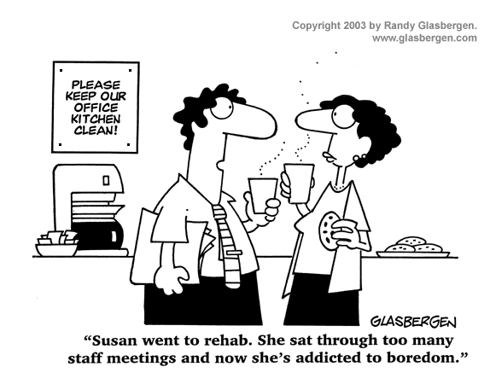
Introduction
83% of employees spend a third of their workweek attending meetings.
Attend a meeting and forget details?
Simplify the process of speech recognition and summarization
Meetings
Multiple speakers
Long Conversations
Upload a meeting recording to get the full meeting transcript and summary.
Useful for team leader, team member, and persons with hearing disability

Slide 3
Summarization
What is an effective summary?
Prose vs. Dialogues/Conversation
Understand multi-speaker context
Extractive vs. Abstractive (Highlighter vs. Pen)
Why Abstractive?
Better, more human friendly
Information unstructured
More challenging
Computationally intensive
Notes:
Extractive summarization means identifying important sections of the text and generating them verbatim producing a subset of the sentences from the original text; while abstractive summarization reproduces important material in a new way after interpretation and examination of the text using advanced natural language techniques to generate a new shorter text that conveys the most critical information from the original one.

Slide 4
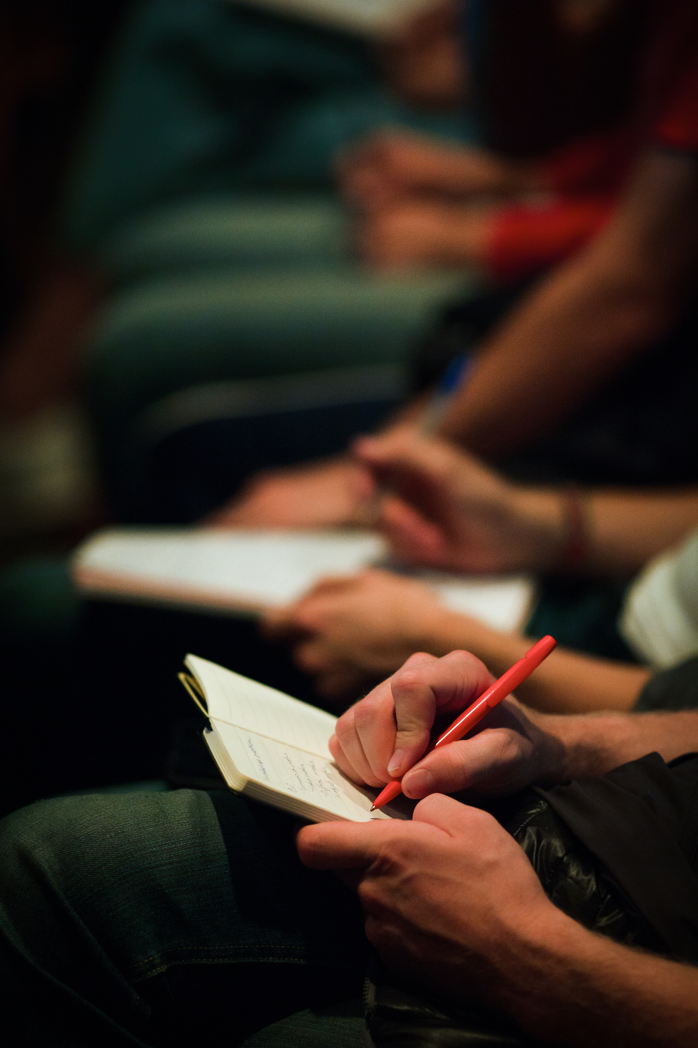
Sample: Extractive vs. Abstractive
DIALOGUE
Speaker 1: Hi, How are you doing today?
Speaker 2: I’m doing well, thanks for asking. How about you?
Speaker 1: I’m doing pretty well too. So, what brings you here today?
Speaker 2: I wanted to talk to you about the project we’re working on. I think there’s a better way to approach it.
Speaker 1: Oh really? Tell me more about what you are thinking.
EXTRACTIVE SUMMARY
Speaker 1 and Speaker 2 talked about the project they’re working on, and Speaker 2 has a better way to approach it.
ABSTRACTIVE SUMMARY
Two colleagues discussed their project, and Speaker 2 proposed an alternative approach that they should take into consideration for the project.

Slide 5
Data
AMI Corpus: 100 hours
ICSI Corpus: 70 hours
Duration 20 mins to 1 hour 30 mins
169 .wav files of work meetings
Multiple speakers are interacting
Reference Summaries made by humans

Slide 6















System Framework
Core tools
Cloud tools
Data Collection
Open AI
Whisper
AMI
ICSI
Audio
Transcription of Meeting
Reference Summary
Audio Files
Processing before summarization
JSON Data
Transfer Learning
BART
Summarization Model
Django
Framework
Website
Combine
Pyannote
Summary
Diarization of Meeting
Reference Summary
Speech to Text Conversion
Text Summarization
User Interface

Slide 7
Transformers
My
name
My
name
is
Self-supervised language models
Relies on the concept of Attention Layers
My
name
is
Sylvian
My
name
is
Sylvian
.
Output
Causal Language Modeling
Decoder
Encoder
My
[MASK]
is
Sylvian
.
name
Masked Language Modeling
Input
Output (Shifted Right)

Slide 8
History of Transformers
2018 2019 2020 2021
T5
GPT-3
GPT
GPT-2
ALBERTA
ELECTRA
M2M100
XLM
BERT
RoBERTA
BART
DeBERTa
LUKE
XLNet
DistilBERT
Longformer

Slide 9
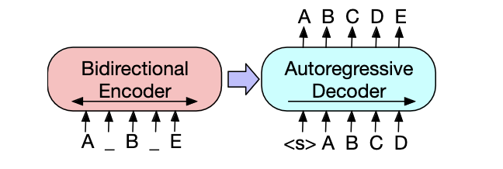
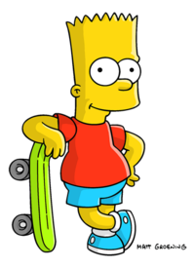
BART MODEL
OUR MODEL – TRANSFER LEARNING BART SUMMARIZATION MODEL
A sequence-to sequence language model
Generalizes BERT (Encoder) and GPT (Decoder) language models
New Data
AMI ICSI
Source Model
BART
Pre-trained on CNN + Daily Mail + SAMSUM
Target Learning Fine-tuned Language Model
News Articles from CNN and The Daily Mail
Phone text messages from SAMSUM
“Amanda: I baked cookies. Do you want some? Jerry: Sure! Amanda: I'll bring you tomorrow :-)”
Trained for Epochs = 5

Slide 10
Metrics for Summary
Qualitative vs. Quantitative
Qualitative: Comparison with Reference Summary
Quantitative: ROUGE (Recall-Oriented Understudy for Gisting Evaluation)
Machine
Machine
The, fox, jumps, over
The fox jumps over
Reference
Reference
The, fox, jumps
The fox jumps
ROUGE-1
ROUGE-L

Slide 11
Quantitative Results
 | ROUGE-1 | ROUGE-LSum
BART (CNN + SAMSUM) | 22.72 | 14.70
Our Model (CNN + SAMSUM + ICSI + AMI) | 39.09 | 35.50
Detailed Training Metrics are at: https://huggingface.co/vmarklynn/bart-large-cnn-samsum-icsi-ami-v2/tensorboard

Slide 12
Qualitative Results: Sample 1 – Short prose or short dialogue
Our Summary:
The whole vacation was spent in Paris with my parents. They saw the Eiffel Tower, Notre-Dame Cathedral, the Seine River, and the famous art museums. They also went on a boat tour around the city, and they had a lot of fun sitting in cafes and watching people.
Human Reference Summary:
#Person1# asks #Person2# what #Person2# did during the vacation to Paris. #Person2# saw all the most famous places and enjoyed sitting in cafes most. #Person1#'s looking forward to a vacation.

Slide 13
Qualitative Results: Sample 2 – LOTR
Our Summary:
The meeting began with the forging of the Great RINGS, each set with a single GEM, which were given to the Dwarf Lords, great miners, and craftsmen of the mountain halls. Next, the meeting moved onto a discussion of the design of the New Line Cinema's next project, which was due to be presented in the next meeting. Then, the group moved onto the discussion of how they would govern each other and their own lives. They discussed how they could make the best use of the power they had, and decided that they would have to be more like the KINGS of Men. Finally, they talked about how to make the project a success. The meeting ended with a brief discussion of their next meeting

Slide 14

USER INTERFACE DEMONSTRATION
Link to Demo: https://youtu.be/3fHrQ8I0j4c
Link to Repository: https://github.com/vmarklynn/parrot
Link to Model: https://huggingface.co/vmarklynn/bart-large-cnn-samsum-icsi-ami-v2

Slide 15
Qualitative Results: Sample 3 – Long Meeting
Our Summary:
This is the first meeting of the new remote control project. Project Manager introduced the team members to each other and the project manager. The team first got acquainted with each other by drawing their favourite animals. Next, the team discussed the working design of the remote control device. They decided to make it more user-friendly than the previous one, so they made some changes to the design. The final product would be a remote control with a fancy look, ease of use, and cost 25 Euros.
Human Reference Summary:
Manager gave the team members a brief introduction of the new remote control project, then the team started an ice breaking game by drawing their favourite animals. The expected selling price of the remote control is 25 Euros and the production costs would be limited to twelve and a half Euro per unit. Marketing plan would depend on overhead costs. The team agreed that the remote needs to be robust, and they wanted it to be a device for all with accessible buttons. Project Manager suggested it to be only a television remote control instead of a multi-functional one.

Slide 16
Future Work & Conclusion
Going forward, we want to make our application more marketable to companies by improving the summarization capabilities and providing accurate and insightful analysis of workplace meetings.
Add more application features
Improve Summarization Model
Improve model with data however we need reference summary.
Visualization of meeting using colors and waveforms
Speaker Recognition - learn overtime to recognize previously encountered voice
Sentiment Analysis
Volunteers are always welcome!

Slide 17
Thank you
Link to Repository: https://github.com/vmarklynn/parrot
Link to Model: https://huggingface.co/vmarklynn/bart-large-cnn-samsum-icsi-ami-v2
Link to Demo: https://youtu.be/3fHrQ8I0j4c

Slide 18
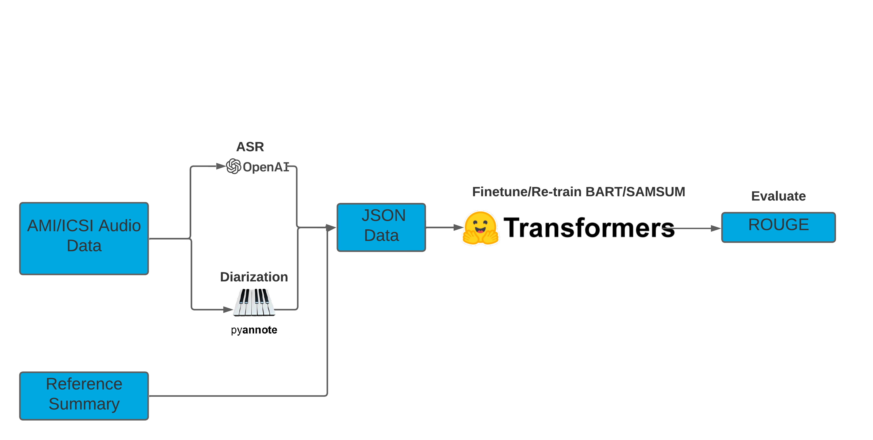
Annexure 1: Basic Model Diagram

Slide 19
Transfer Learning
$$$ Compute
$$$ Compute
Base
Model
Pre-trained Language Model
Pre-trained Language Model
Fine-tuned Language Model
Very Large Corpus
Days of Training
Training on Single GPU
Easily Reproducible
Training Models
Transfer Learning

Slide 20
Annexure 2: Complete List of Tools/Packages
Python 3.8
Jupyter Notebook, VSCode, Datalore
FFMEG
Whisper Open AI
Pyannote
PyTorch
CUDA
Hugging Face Transformers
AWS
BART - Model
Github
Django
HTML
CSS
Javascript

Slide 21
Annexure 3: Complete Metrics Definitions
All rouge scores and formulas here
Rouge-N: This measures the overlap between the generated text and the reference text in terms of n-grams. To compute the Rouge-N score,
Tokenize the generated text and the reference text into n-grams of size N.
Compute the number of overlapping n-grams between the generated text and the reference text.
Compute the precision, recall, and F1-score using the following formulas:
Precision = Number of Overlapping N-grams / Number of Tokens in the Generated Text
Recall = Number of Overlapping N-grams / Number of Tokens in the Reference Text
F1-score = (2 * Precision * Recall) / (Precision + Recall)
Rouge-L: This measures the overlap between the generated text and the reference text in terms of longest common subsequences. To compute the Rouge-L score,
Tokenize the generated text and the reference text into individual words.
Compute the longest common subsequence between the generated text and the reference text.
Compute the precision, recall, and F1-score using the following formulas:
Precision = the calculated LCS / Number of Tokens in the Generated Text
Recall = the calculated LCS / Number of Tokens in the Reference Text
F1-score = (2 * Precision * Recall) / (Precision + Recall
Rouge-Lsum: This is similar to the previous metric, Rouge-L, but it is computed over a whole text whereas Rouge-L is obtained by calculating the average over individual sentences. Essentially Rouge-Lsum includes an additional length normalization factor to account for differences in the length of summaries. This factor is based on the length of the reference summary.

Slide 22
Annexure 4: Original Text for Sample 1: Short Prose or Dialogue – The Paris Vacation
#Person1#: So, how was your vacation? You went to Paris, didn't you?
#Person2#: Yeah, with my parents. We just got back on Saturday. It was wonderful!
#Person1#: What sights did you visit?
#Person2#: Well, we saw all the most famous places, the Eiffel Tower, Notre Dame Cathedral... They were so interesting.
#Person1#: Did you take any tours?
#Person2#: Just one - a boat tour on the Seine River.
#Person1#: Wow! That sounds fantastic.
#Person2#: Yeah. It was a great way to see the city.
#Person1#: Did you go to any of the famous art museums?
#Person2#: Yeah. My parents love art, so they spent hours in the museums. But for me, it was pretty boring. I'm just not very interested in paintings.
#Person1#: So, what else did you do?
#Person2#: Well, I guess my favorite thing to do was just to sit in cafes and watch the people. It was really relaxing, and French coffee is terrific.
#Person1#: It sounds like a great vacation to me. But I have work at hand. Hopefully I'll be there one day."

